Slide 1

A wind tunnel for kids…
Status Update
October 27, 2011

Slide 2
Activities this week
Technical Risk Reduction
Android NDK Prototyping
Mapping requirements to prototypes
Emailed Sean
Draft SRS and Virtual Wind Tunnel Mockup
Waiting for feedback on demo meeting at HOSC

Slide 3
Sources of Technical Risk
Physical Tunnel
Virtual Tunnel
Existing Fan
RPM measurement
Control
Arduino-Arduino communication
Ethernet Communication
Android-Arduino communication
Model Positioning System?
“Nice to have,” but may be difficult to fabricate
“Whiteboard”
Translating user-drawn shape into computational grid
Existing Flow Solver Code
Porting to Android using the Native Development Kit (NDK)
Speed and stability issues?
Translating solver output to lift and drag info
Translating Solver Output To Flow Field Picture
Notes:
Somewhat of a repeat of last week. May continue to brief this slide to track prototyping progress.

Slide 4
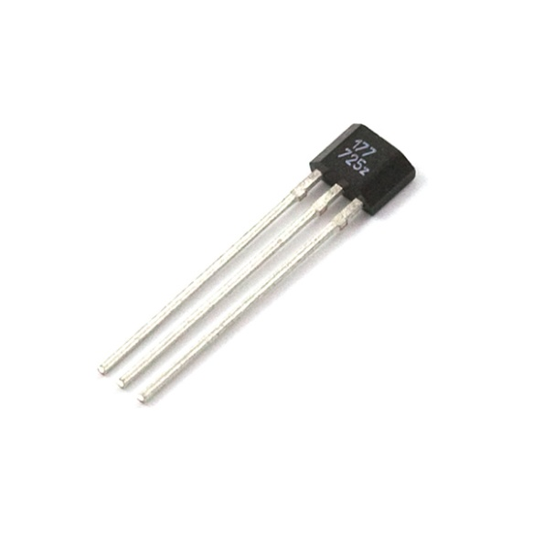
Hall Effect Sensor
Preparing to test on an actual fan
Waiting on some parts from SparkFun
Should have necessary hardware to make 2 hall effect modules for final tunnel

Slide 5

Android NDK
Compiled 2dFlowSolver using NDK (not running yet)
STLPort seems to solve flow solver STL dependency issue
Working on file i/o prototypes
Existing 2dFlowSolver code does a lot of file i/o
Packaging for Android and JNI issues complicate matters
Current prototype can package an input file, read it in NDK, pass results back up to JNI

Slide 6
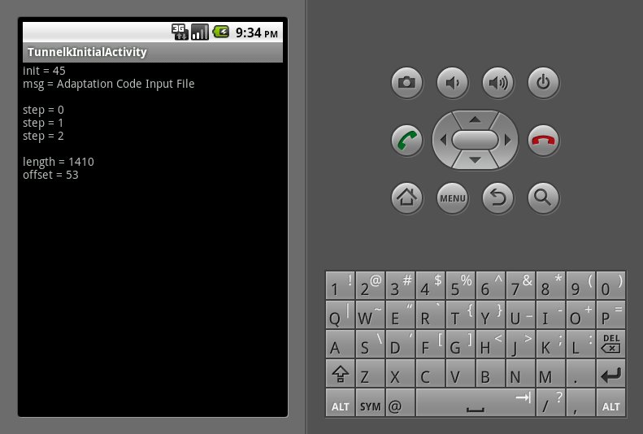
Android NDK

Slide 7
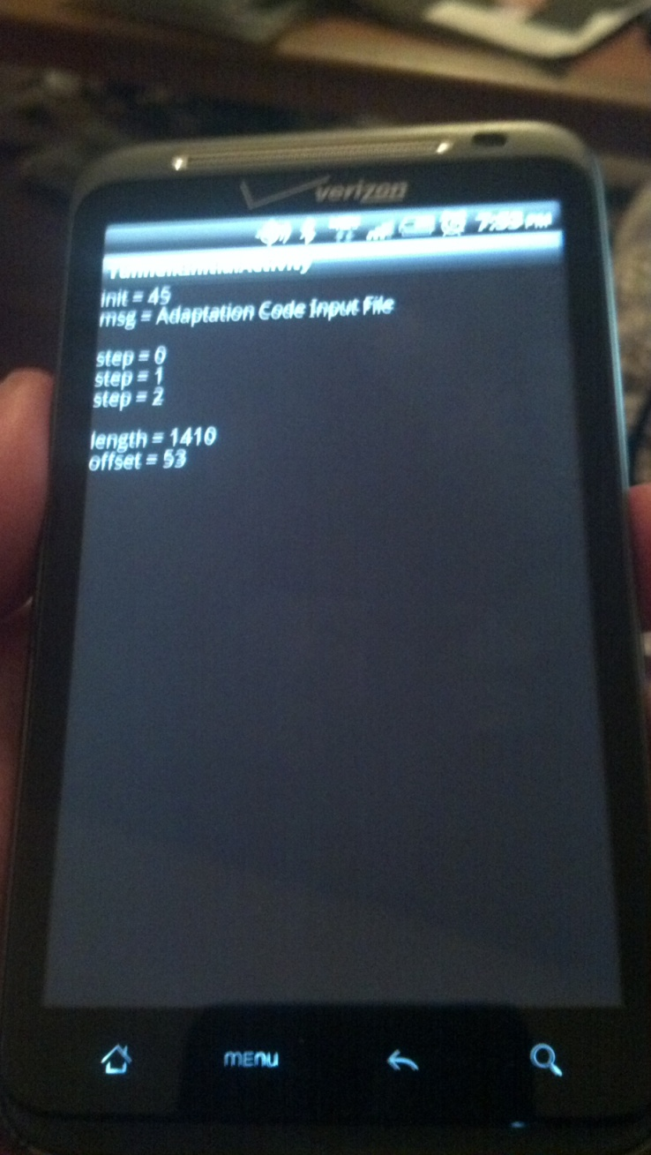
Android NDK

Slide 8
Android NDK: Next Steps
Convert 2dFlowSolver input files to Android Assets
Modify 2dFlowSolver to use Android Logging system for debug output
Handle 2dFlowSolver output files somehow
Prototype OpenGL flow field visualization
Prototype “whiteboard” mesh-drawing

Slide 9
Requirements Coverage
Physical Wind Tunnel Prototypes
Hall Effect Sensor, Temperature Sensor, Pressure Sensor, Fan Control
Requirements Coverage
3.2.1: The system shall implement a small-scale physical wind tunnel.
3.2.5: The system shall include methods for physical wind tunnel operation feedback. For example: live display or tunnel sensor parameters, time history plots of tunnel sensor parameters, et al.
3.2.6: The physical wind tunnel system shall include reporting capabilities to select social networks.
3.14.1: The hardware sensors and instruments used by the tunnel shall be off-the-shelf and easily obtainable a third party attempting to recreate the tunnel design.

Slide 10
Requirements Coverage
Virtual Wind Tunnel Prototypes
2dFlowSolver execution, Whiteboard, Flow field
Requirements Coverage
3.2.2: The system shall implement a virtual wind tunnel, also known as a two-dimensional computational fluid dynamics flow solver.
3.2.4: The system shall include method of applying input virtual wind tunnel conditions. For example: air speed, angle of attack, temperature, et al.
3.2.9: The system should include a computational geometry input method similar to a whiteboard app to the virtual tunnel via modern hand held devices.
3.2.12: The virtual wind tunnel should provide outputs such as lift, drag, mach number, pressure, etc.
3.13.1: The virtual wind tunnel should run a complete visualization and display the outputs in less than 1 minute on a modern hand held device.
3.15.2.1: The software components of the system shall be open source or freely available to a third party attempting to recreate the tunnel software components.

Slide 11
Requirements Coverage
Total Projected Requirements Coverage: 10/24
Most high-risk technical requirements projected to be covered
Uncovered:
Most non-functional requirements
Integration between components

Slide 12
Workload
 | Requirements | Design | Code | Doc | ROM | Prototyping |  | Totals | Totals to Date | Expected | Delta
Josh Calahan |  |  |  |  |  | 11 |  | 11 | 60 | 70 | -10
Wes Cothran | 8 |  |  | 2 |  |  |  | 10 | 61 | 70 | -9
Chris Davis |  |  |  | 5 |  | 5 |  | 10 | 60.5 | 70 | -9.5
Michael Lynch |  |  |  | 5 |  | 5 |  | 10 | 55 | 70 | -15
Brian Pittman |  |  |  | 4 |  | 7 |  | 11 | 62 | 70 | -8
Totals | 8 | 0 | 0 | 16 | 0 | 28
Totals to Date | 129 | 65 | 14 | 45.5 | 13 | 44
Expected | 150 | 75 | 0 | 65 | 10 | 50
Delta | -21 | -10 | 14 | -19.5 | 3 | -6

Slide 13

Follow us on Twitter… 4 followers – 47 tweets
@TunnelK
Notes:
Initial social network of choice…

